Slide 1

NativeScript!
Notes:
Alright I’m going to go ahead and get started.

Slide 2
TJ VanToll 🚀
@tjvantoll
Notes:
I’m TJ. I’ve never happy to be here at Fluent. Happy to be in San Jose also as I had never been.
It’s kind of funny because the one fact I knew about San Jose is that the

Slide 3

Notes:
San Jose Sharks play here.

Slide 4
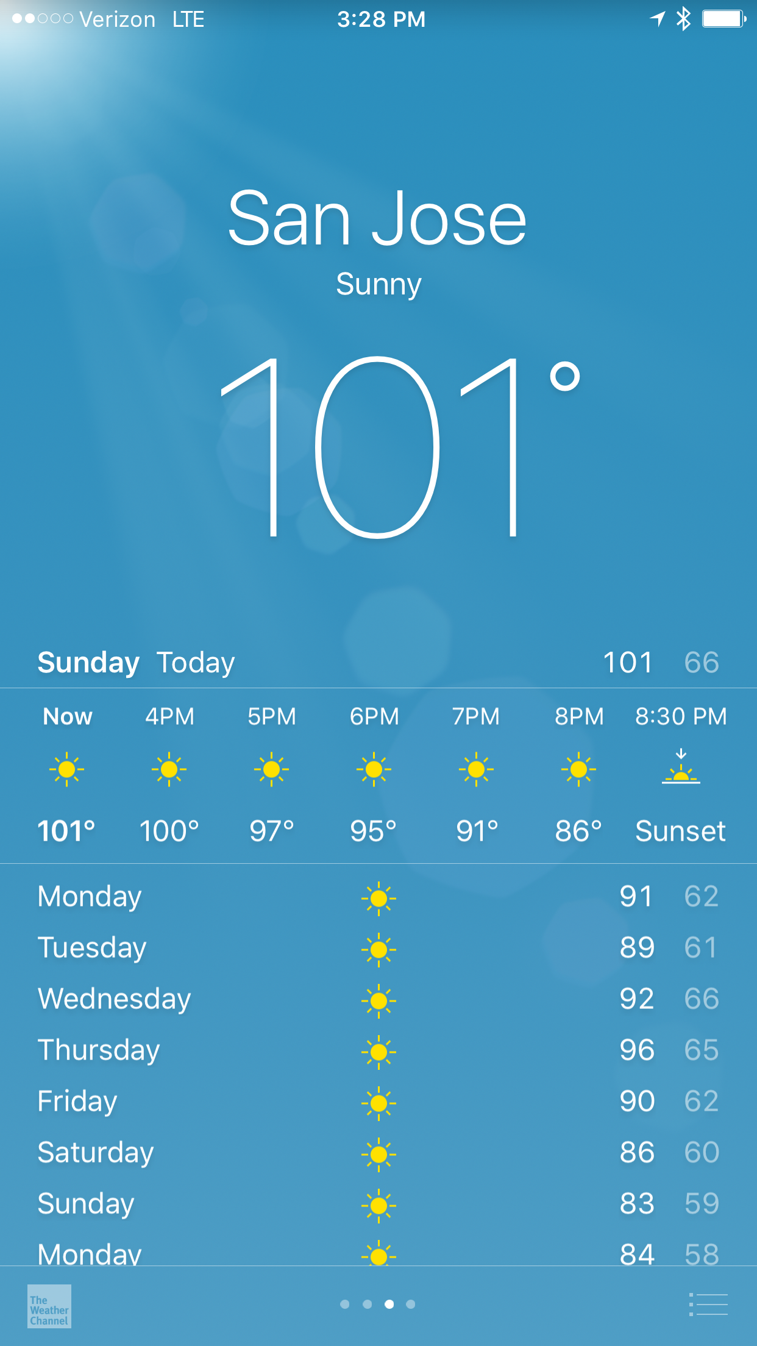
💦
🔥

Slide 5

Notes:
And I know this because I’m from the great state of Michigan, where we know a thing or two about hockey.

Slide 6
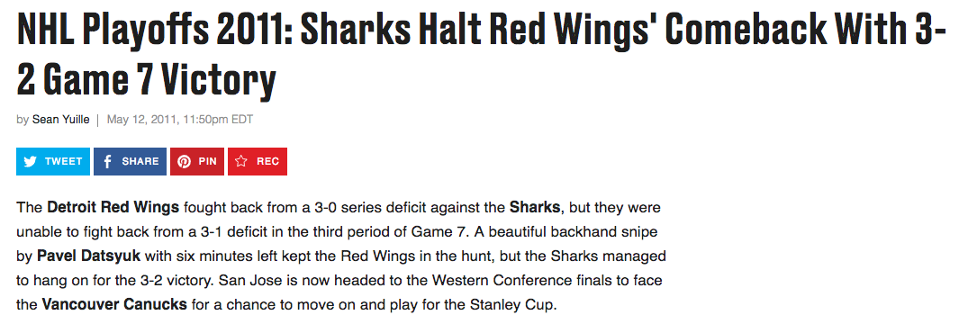
Notes:
This was hard to take, not only because the Red Wings lost in a gut wrenching way, but we lost to a team where the weather gets like this

Slide 7

Notes:
Then you don’t get to participate in the wonderful sport of hockey.

Slide 8



Notes:
In the wintery wonderland of Michigan, I work remotely for a company called Progress

Slide 10
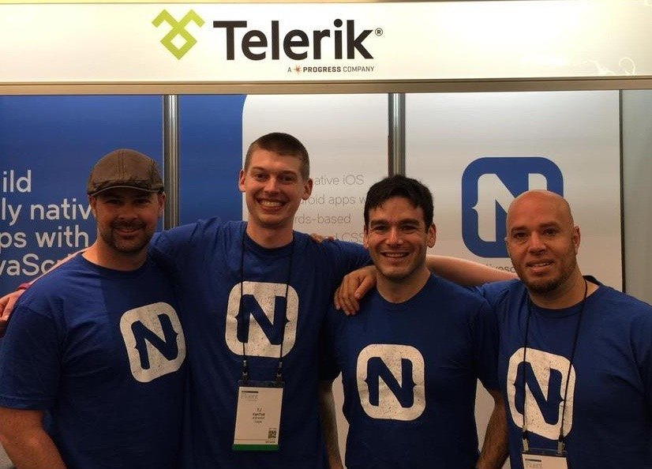

Slide 11
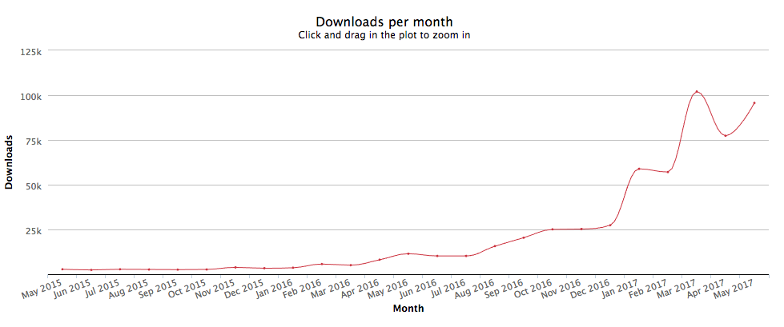
📈 😍
Notes:
Now that people are actually using {N} in a pretty big way.

Slide 12
NativeScript is an open-source framework for building truly native mobile apps.

Slide 13
Agenda
Slides
~10 minutes
Demos
~30 minutes
🔥
😎

Slide 14
Slides
Why build a native app?
Why use NativeScript?
Notes:
But I do want to briefly answer a few questions, both because they come up a lot, and also because I’ll refer back to these answers when I demo {N} here in a minute.

Slide 15
Why build a native app? 🤔
Notes:
I think it’s important to have a good answer to this, because

Slide 16
Notes:
Native apps are not easy. I don’t care if you’re using NativeScript, Ionic, React Native or whatever. Building a native app is going to be harder than building an app for the web—there’s no point sugar coating that.
But there are some compelling reasons to go down the native road, even with all the advances the web has made, and even with technologies like Progressive Web apps now being around. To keep things brief I’m going to give you 3.

Slide 17
3 reasons
Notes:
And then I’m going to refer back to these reasons when I start demoing {N} in a minute.

Slide 18
Why build native apps?
1) Performance 🐎
Transitions
Animations
Lists (scrolling, pull to refresh, endless scroll)
Notes:
The first reason is performance, which is sort of the canonical justification for native app development.

Slide 19
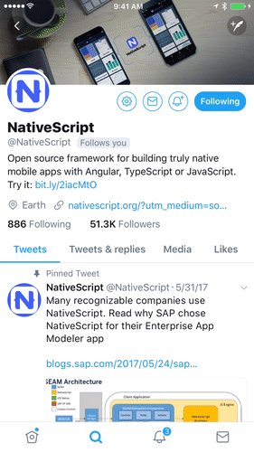
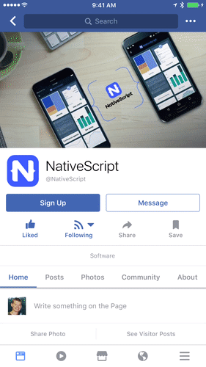

Slide 21
Why build native apps?
2) Native APIs 📷 🗺️ 📹
Camera extensions, geolocation, native SDKs, connectivity,
Flashlight, accelerometer, audio, phone, SMS, fingerprint,
Text to speech, maps, sharing, contacts, notifications,
Vibrate, ads, bluetooth, 3d touch, permissions, video

Slide 22
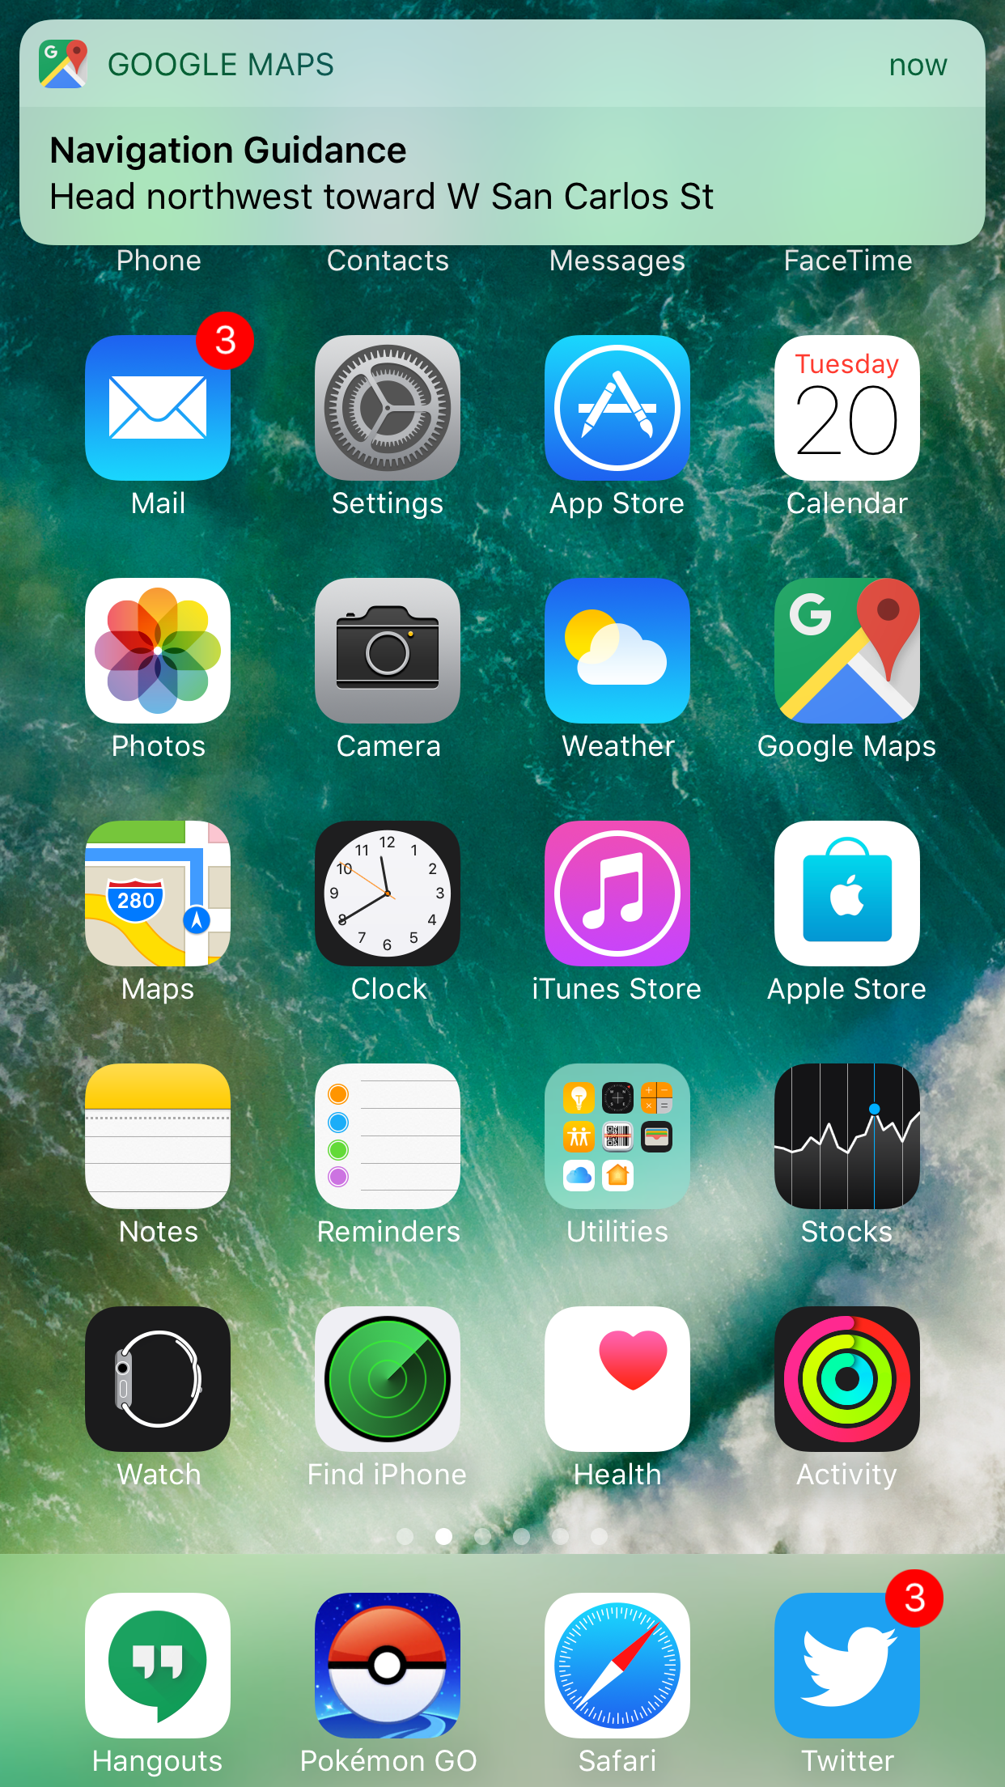

Slide 23
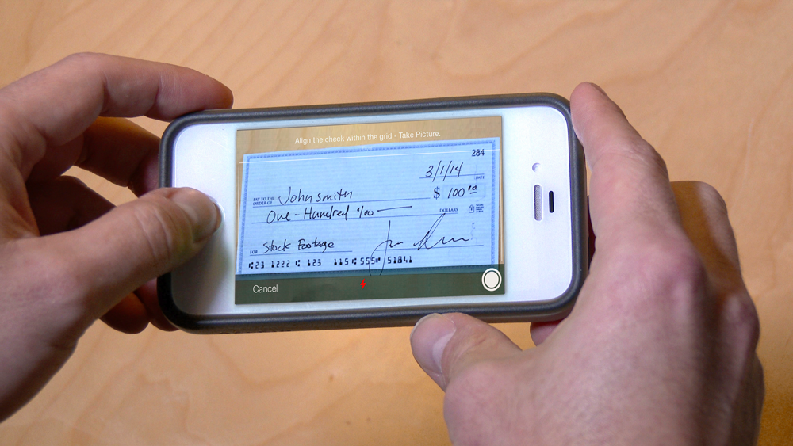

Slide 24
Why build native apps?
3) Learn something new
Notes:
For the same reason that learning new programming languages can help expand your horizons as a software developer, learning to develop for new platforms can really give you a new perspective on how you approach your day-to-day problems, even if you primarily work on web apps.
So even if you can’t convince your company to take the plunge into native app development, I’d highly encourage you to play around even if you’re just working on a side project or a fun little app you want to build for your family or friends—and this applies by the way, regardless of whether you use {N}, React Native, or whatever.

Slide 25
Why use NativeScript to build mobile apps?
Notes:
I could give a long complex answer to this, but the short reason is

Slide 26
Performance & ease of doing native-y things.
Notes:
Performance, and the ease of using native APIs, aka the exact reasons that are compelling reasons to build a native apps in the first place.

Slide 27







Notes:
And instead of talking how {N} enables you to do these things in the abstract, I’m going to switch over now and off NativeScript in action.

Slide 28
Demo! 🔥
Notes:
I’m going to give you two quick notes before I get started.

Slide 29
Architecture Choices 🔧
or
or

Slide 30

Notes:
My second note is that I’m a 32-year-old adult that’s an enormous Pokémon fan.

Slide 31


Slide 32

Notes:
I’m a level 37 Pokemon GO player, which, for those of you that don’t play Pokémon GO, it basically means that I make very questionable use of my free time.

Slide 33
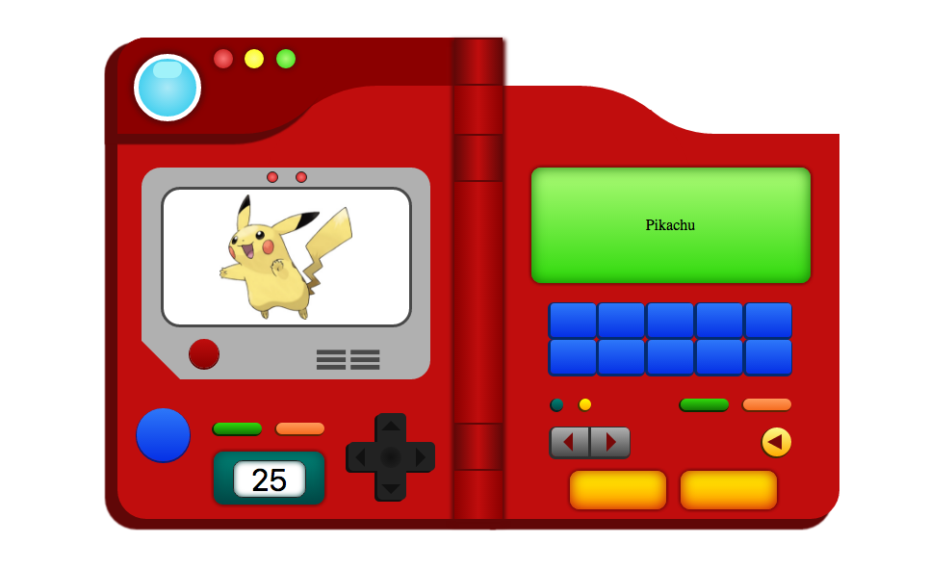

Slide 34
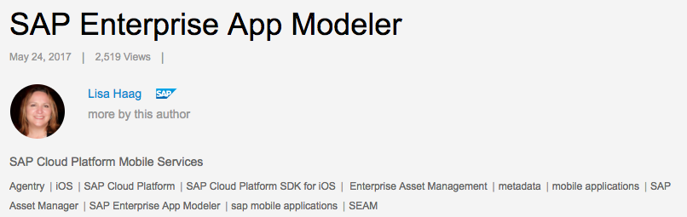
“The SEAM application architecture is built on NativeScript using open industry standard technologies such as JavaScript, JSON and OData.”
http://bit.ly/nativescript-sap

Slide 35
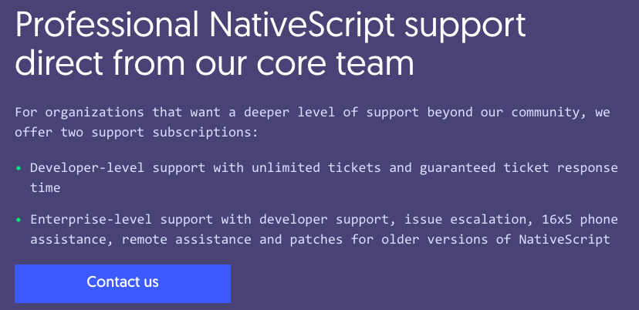
https://www.nativescript.org/enterprise

Slide 37
Follow NativeScript!
nativescript.org/nativescript-newsletter
twitter.com/nativescript
Notes:
Want to keep up on the latest and greatest in the NativeScript world? Sign up for the NativeScript newsletter, and follow the @NativeScript handle on Twitter.

Slide 38
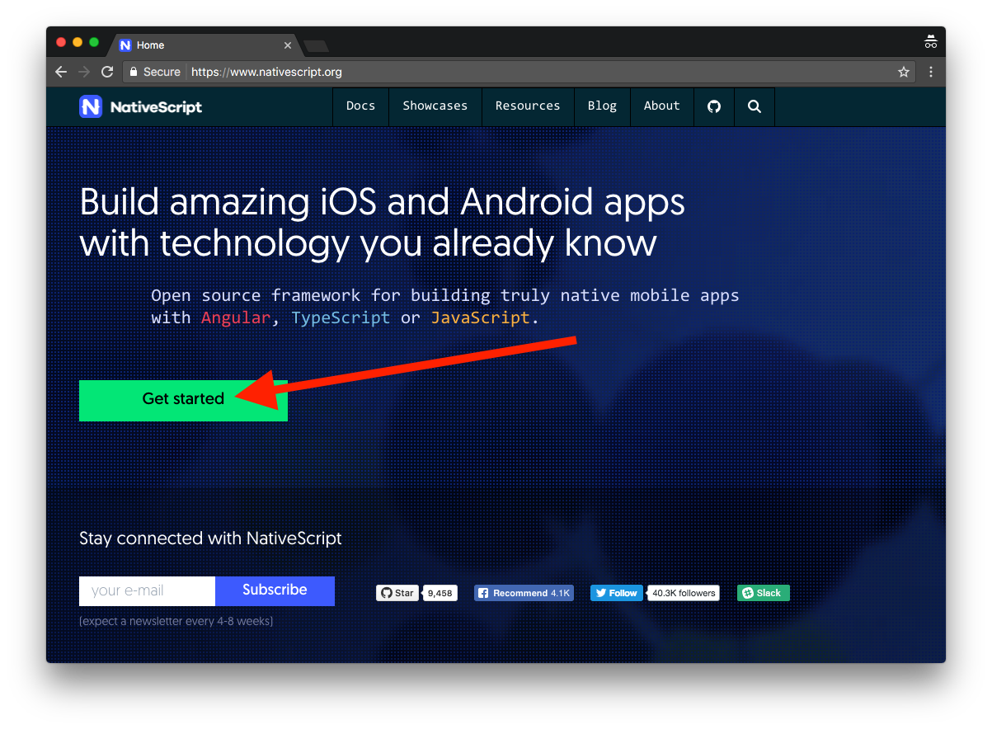
Get Started
Notes:
If you’re interested in what you’ve heard today and want to try NativeScript out, head to nativescript.org and hit the big Get started button. From there go through one of the two tutorials, NativeScript with JavaScript, or NativeScript with TypeScript and Angular.

Slide 39
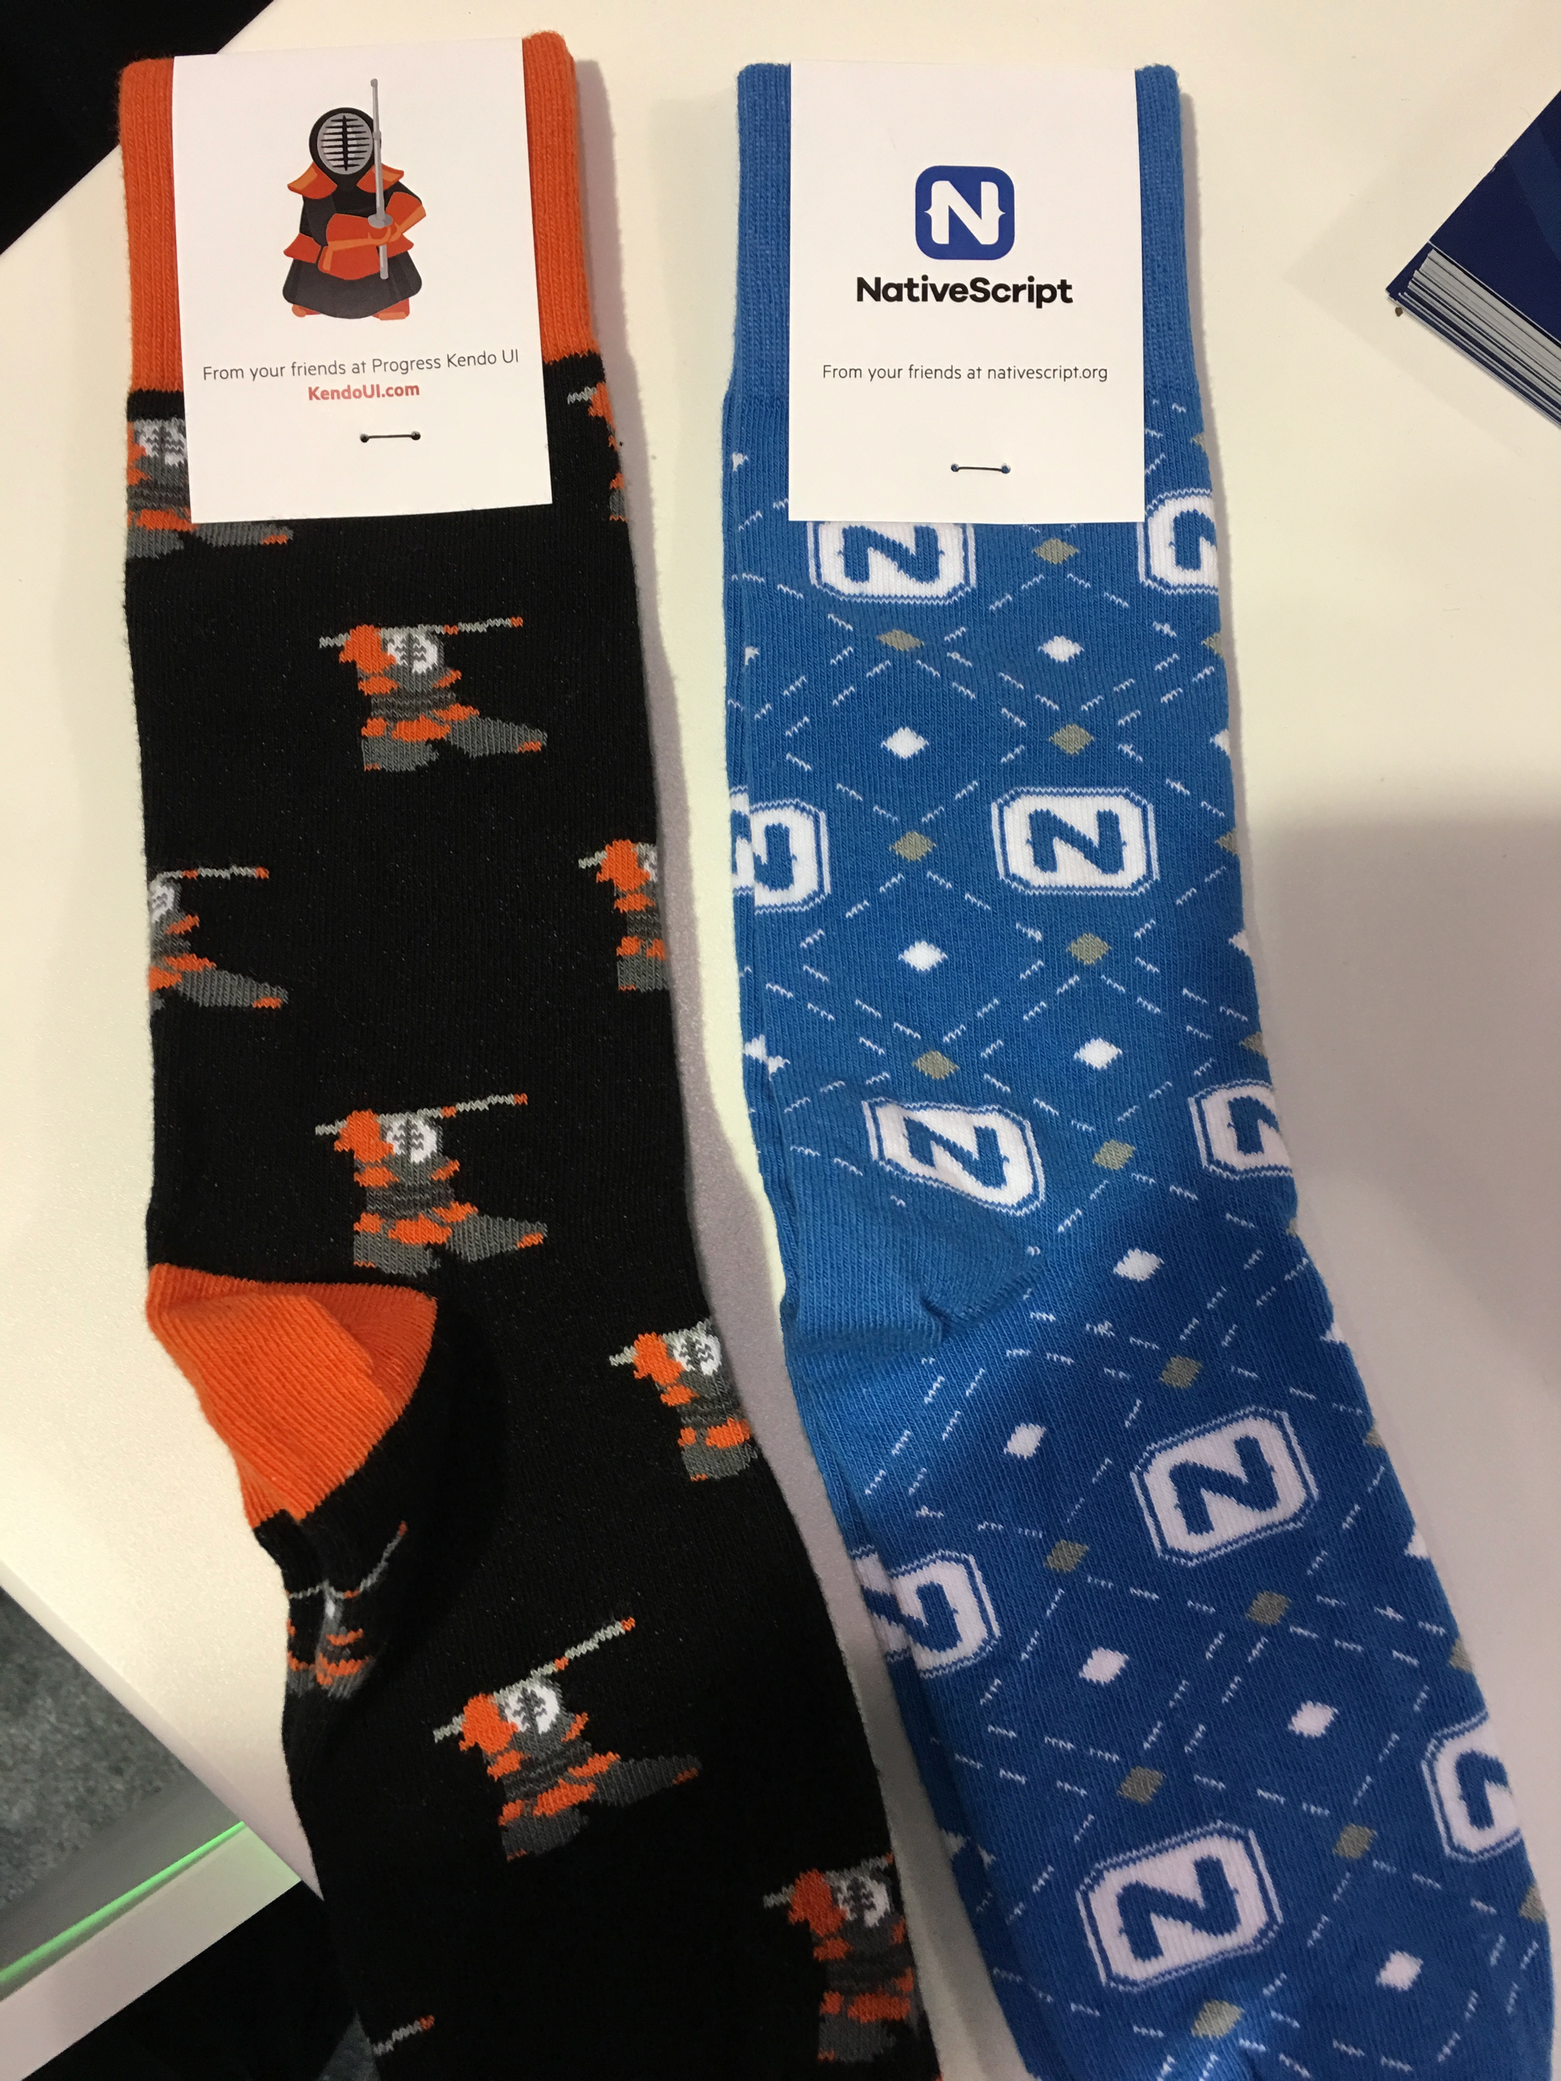

Slide 40
Thanks! 😊
@tjvantoll
Notes:
We have a booth (Progress)

